Slide 1
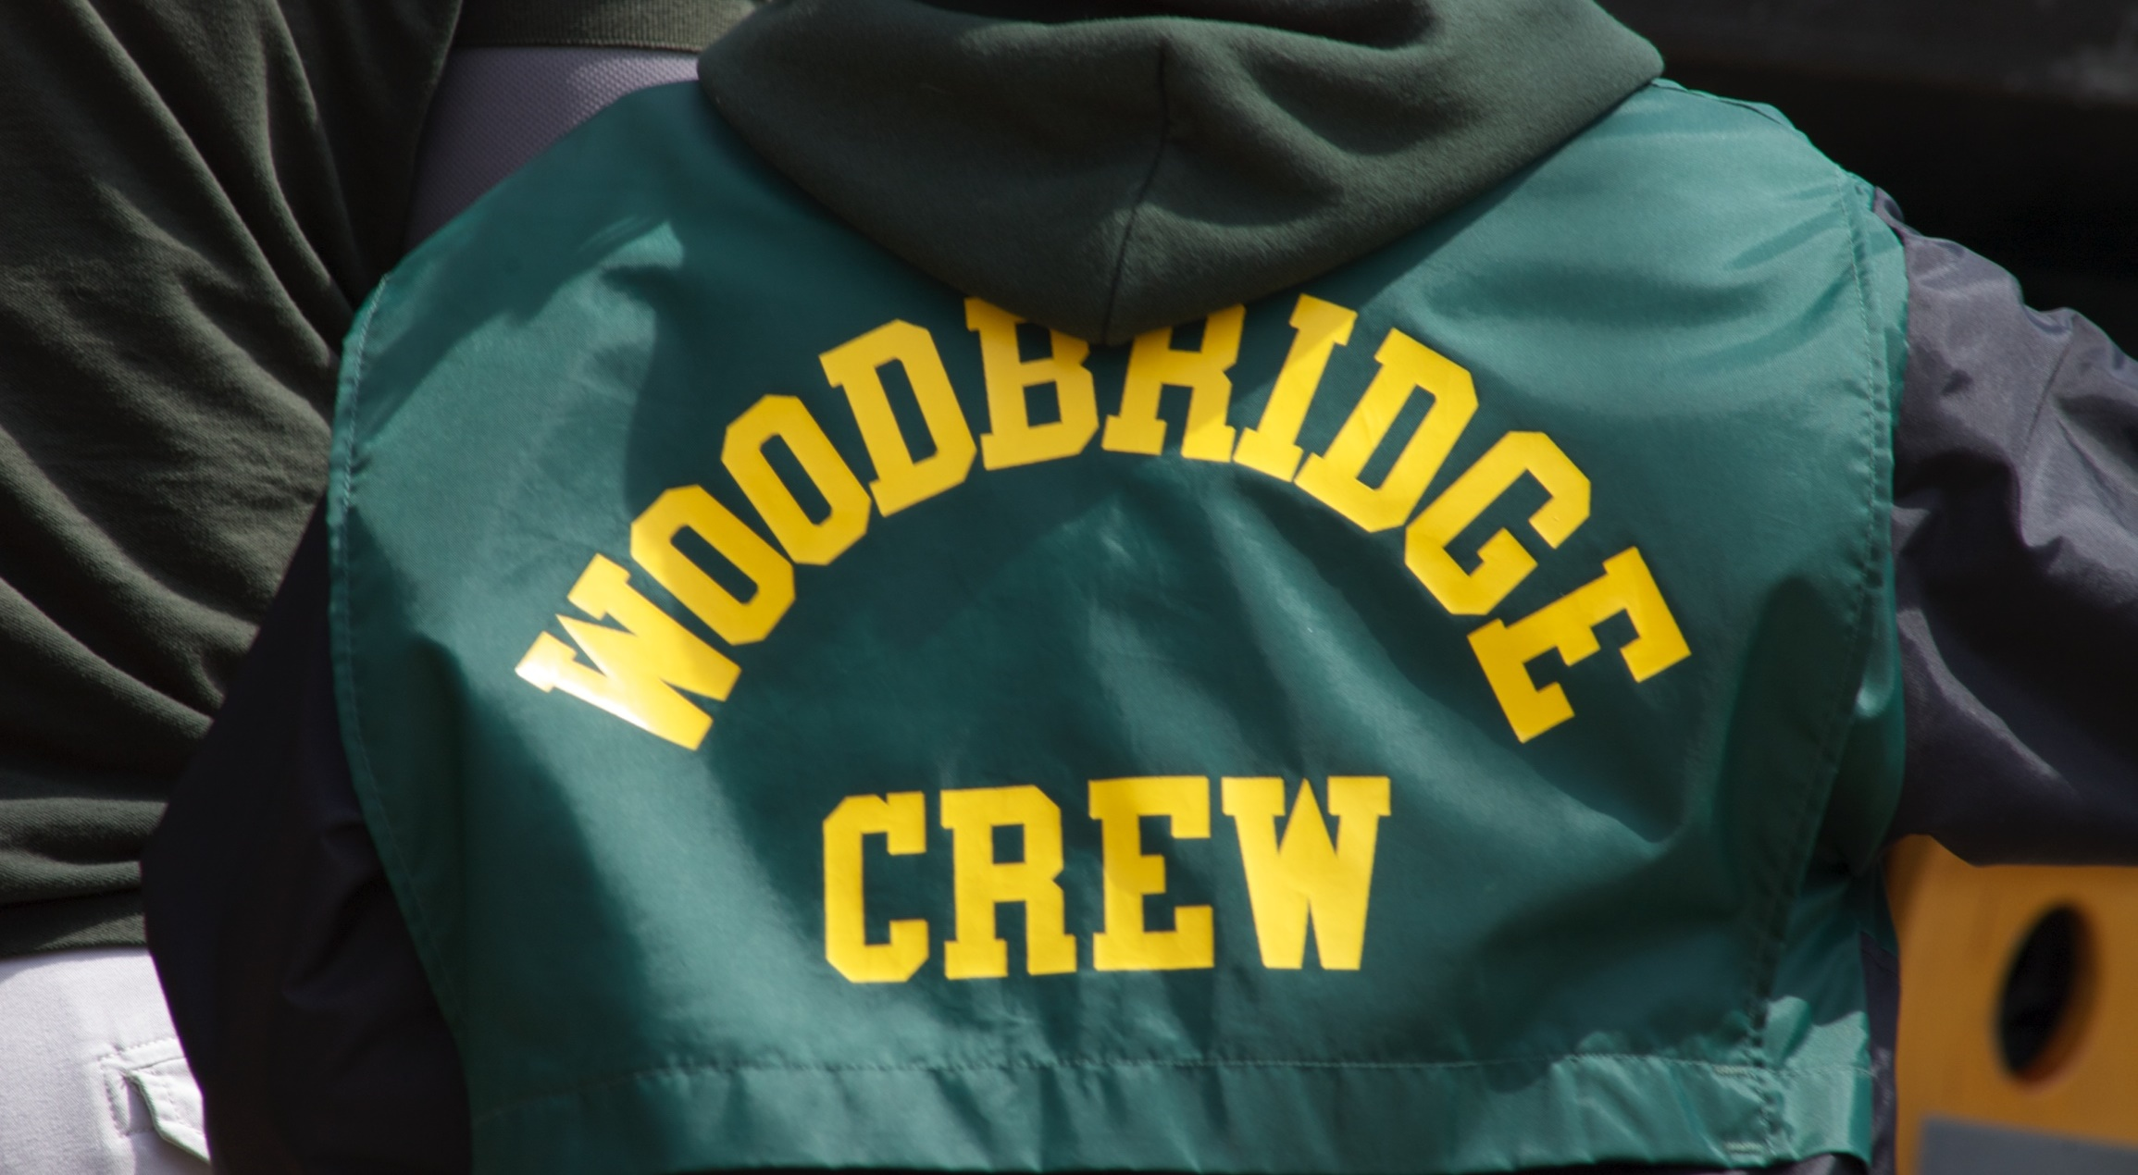
Spring Interest Meeting
Wednesday, Jan 26, 2022 at 7:30 PM
WSHS Upper Cafeteria

Slide 2
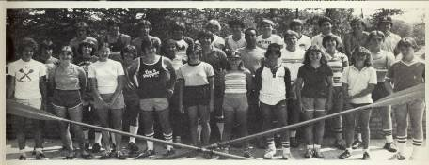
Woodbridge Crew Tradition
Longest Running/Most Successful in PWC
1982 Woodbridge Crew Team

Slide 3
2021-2022 Woodbridge Crew Board
Board Position | Name | Vacant at end of Season
President | Drew Protacio | X
VP Administration | VACANT
Treasurer | Mahesh Balagangadhar
Secretary | VACANT
Public Information | Jennifer Pereira
Fund Raising | Diane Tivnan
Logistics | Jennifer Weis
Maintenance | Dean Milne
Volunteer Coordinator | Keri Lehtola
Spirit Wear | Stephanie Martin | X
Social Committee | VACANT
Head Coach | Jason Compy

Slide 4
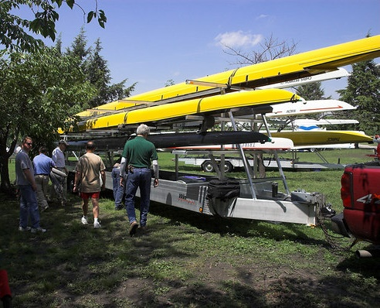
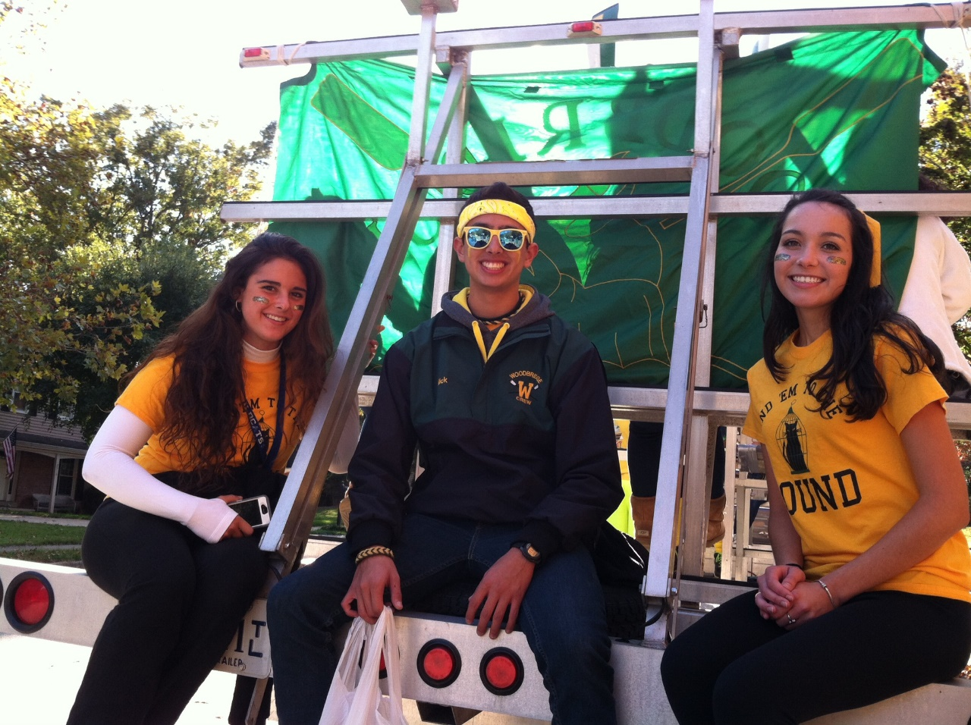
What It Takes to Run The Program
$ 410,000 Total Assets:
  (Racing shells, oars, launches, ergs, motors, and trailer)
$ 40,000 approximate cost of 8 man racing shell
$ 12,000 operations & maintenance cost
$ 10,000 boat storage/dock fees paid to PWCA (Oxford Boathouse)
$ 8,000 insurance (equipment and rowers)
$ 23,000 total expenses average last three years (not counting new assets)
$ 800/year cost per rower
Income is Spring Registration fees and fund raisers

Slide 5
What It Takes to Run The Program
Parent VOLUNTEERS
  Each family is required to sign up for at least three volunteer jobs
  Occoquan Regatta duties
    Boat drivers, concessions, parking (sign-up genius used)
    Boat driver training: TBD
    Point set-up (tents, food, water)
  Away Regattas
    Kitchen staff, cooks, shoppers, set-up, recovery,
    room chaperones
Fundraising support (Tag Day drivers/Support to local races)

Slide 6
FUNDRAISING
Spring Tag Day (Mandatory for all rowers) – Saturday, March 5 @ 9am-12pm and 12pm-3pm
Chipotle – Thursday, March 9
Amazon Smile

Slide 7

Crew Costs
Spring Season Rates
New “Novice” Rowers: $550
Experienced Rowers: $600
US Rowing Basic Membership: $9.75 (Access Code: YXAAX)
Uniforms (this year): rowing tank $18
Uniforms (usually uni’s): $80
Spirit Wear: Variable cost depending upon what you order
Away Regattas
Nationals (qualifying boats only)
Payments
We partnered with:
(payment plans are available)

Slide 8
Uniforms and Spirit Wear
  Uniforms will consist of:
  Tops: Tank top – to be ordered after tryouts
  Bottoms: Black spandex shorts or rowing trou (purchased separately by each rower)
  Uni’s
  Spirit Wear - an order form will be ready to be distributed after tryouts. Completed order forms and payments will be accepted at specific days of practice.

Slide 9
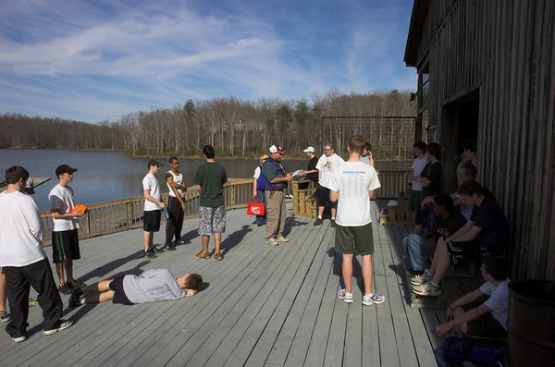
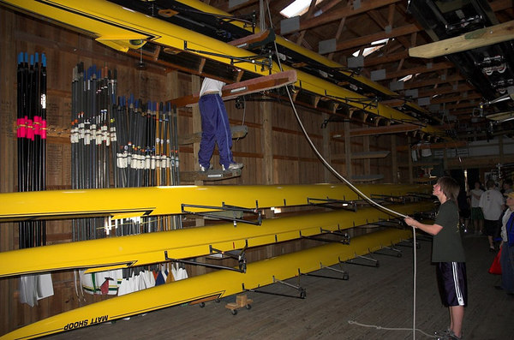
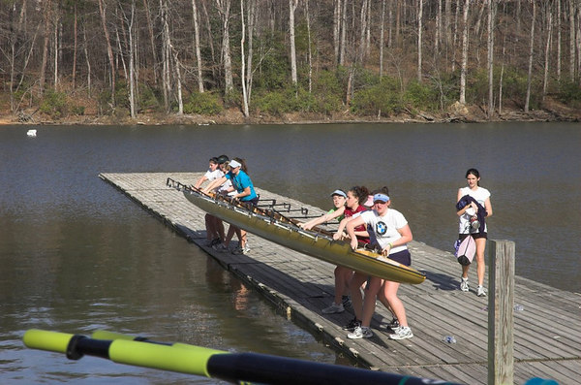
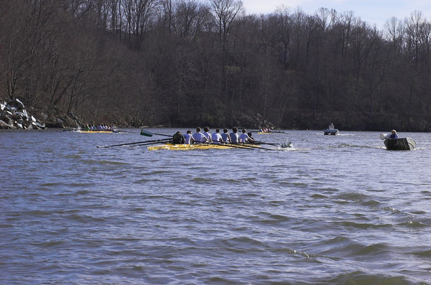
Typical Practice Day
Assembling at the boathouse
Taking boats from the racks
Into the water
On the Occoquan

Slide 10
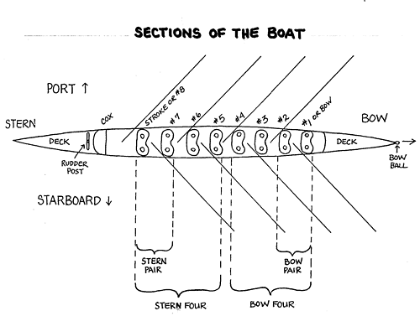
Sections of the Boat

Slide 11
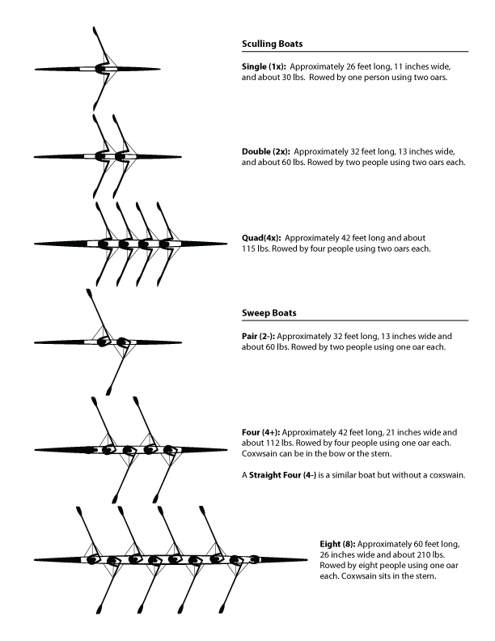
Boat Types

Slide 12
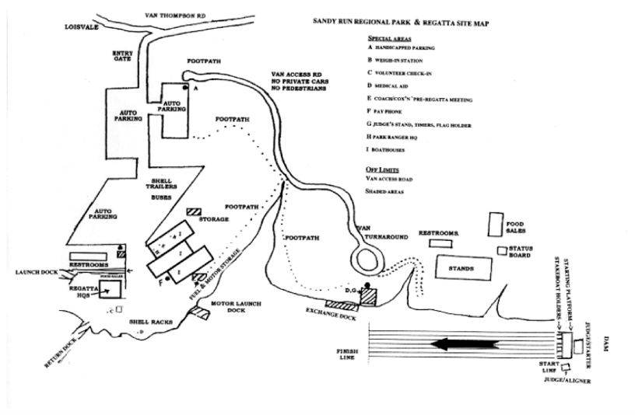
REGATTA LOCTION
Sandy Run Rowing Facility
Volunteer check in
The Point

Slide 13
Woodbridge Crew Coaching Staff
Jason Compy – Coach Compy | Head Coach and Men’s Varsity
Kris Sorensen – Coach Kris | Women’s Varsity
Matt Belote – Coach Matt | Assistant Coach
Nick Gomez – Coach Nick | Assistant Coach
Dani Mazer – Coach Dani | Assistant Coach

Slide 14


Slide 15
Spring Season Snapshot
Tryouts
Tuesday, February 22 and Wednesday, February 23 (5:00 PM to 7:00 PM)
Make-up Day – Thursday, February 24 (5:00 PM top 7:00 PM)
Team Announced Friday, February 25
Practice
Monday – Friday from 4:30 PM – 6:30 PM
Saturdays – 8:00 AM – 10:00 AM (when not racing)
1st Practice – Friday, February 25
Regattas
Every weekend from March 19 – May 14
May 26 - 29 for qualifying boats (SRAA Nationals)
Spring Break
April 11 – 15
Mandatory for Varsity; highly encouraged for Novices
Thursday, April 14 – Oarsman’s Ball, Westridge Clubhouse

Slide 16
Tryouts – Required
Before you can tryout you MUST:
Have a Physical dated after May 2021. Turn in at main office to Ms. Depetro.
Complete Concussion Training. Turn in at main office to Ms. Depetro. The concussion training can be found at https://online-concussion.pwcs.edu/
Fill out Emergency Card. Turn in at main office to Ms. Depetro AND email to woodbridgecrewcoaches@gmail.com
Register for SWOL (SportsWareOnLine – www.swol123.net)
Complete the Woodbridge Crew Registration Form. Email to woodbridgecrewcoaches@gmail.com
Complete the Release from Liability Form. Email to woodbridgecrewcoaches@gmail.com
Complete Swim Test. Email to woodbridgecrewcoaches@gmail.com
VHSL Requirement - Take and pass 5 courses during the current and previous semester

Slide 17
Tryouts
CRITERIA | GIRLS |  | BOYS
CRITERIA | Returning | Novice | Returning | Novice
1 Mile Run | 8:30 min | 9:00 min | 7:30 min | 8:00 min
1500m Erg | 6:19 min | 6:45 min | 5:35 min | 6:00 min
5K Erg | 22:15 min | 23:30 min | 19:45 min | 21:00 min
Max Watts (3 attempts – watt/weight) | 3.2 | 2.6 | 4.0 | 3.2
RETURNING COXSWAINS | Written Knowledge Assessment
In addition to the above standards, Coach's discretion along with attitude, work ethic and coachability will all factor into the Coach's decisions.

Slide 18
Practice
Monday – Friday from 4:30 PM to 6:30 PM
(Rowers will be in the upper parking lot by 7:00 PM)
1st Practice will be Friday, February 25
Athletes are expected to attend every in-season practice, including those on Saturdays.
Athletes MUST:
Complete SWOL by 12:00 Noon each day
Wear a mask while not on the water
Bring a refillable water bottle
Wear “crew appropriate” clothing.

Slide 19

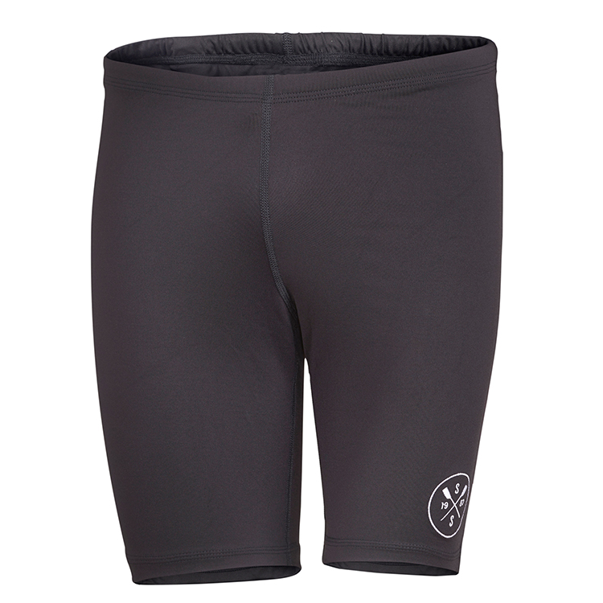
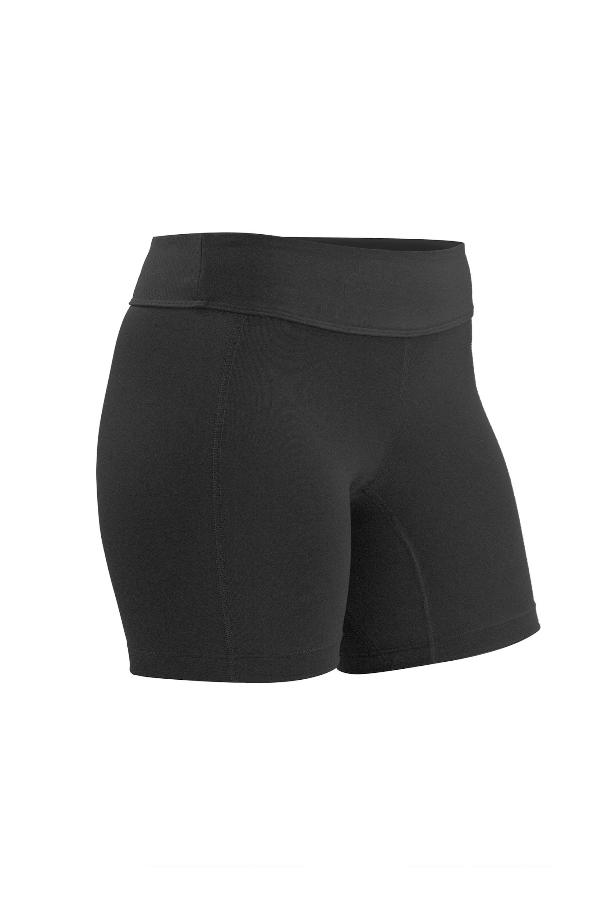


Crew Appropriate Clothing
Wear/bring shoes you are comfortable running in. Yes, crew is a water sport, but you will be doing land workouts, including running.
No short shorts, crop tops, or bare midriff.
No baggy shorts - they can get caught in the slides. Get a few pair of black spandex-type shorts. They can also serve as the bottom half of your uniform.

Slide 20
2022 Spring Regatta Schedule
Mar 19 | Polar Bear
Mar 26 | Regional Park
Apr 02 | Walter Mess
Apr 09 | Darrell Winslow or James River
Apr 16 | Easter Weekend – No Regatta
Apr 23 | Ryz Obuchowicz
Apr 30 | Al Urquia
May 07 | VSRC Day 1
May 14 | VSRC Day 2
May 27 & 28 | SRAA Championships *
* Qualifying Boats ONLY

Slide 21
Regattas
Times will vary based on the size of the regatta and the schedule. Specific report times and length of each regatta will generally be known the week of each regatta.
Sandy Run spectators are only allowed at the Grandstands.
The Point is for rowers and coaches only. Wristbands will be required to gain entry.
Oxford Boathouse is for rowers and coaches only. No waiting for rowers by parents at the boathouse. Unless you have an assigned job, please do not hang around.
A great opportunity to watch the regatta is to volunteer. In the past, Sandy Run has been very good at allowing volunteers to step away to watch their child compete. Some positions offer you better opportunities to view the races, i.e. stakeboat holders, launch drivers, etc.

Slide 22
Lake Ridge Park Rules
Drop off and pick up occurs ONLY in the UPPER parking lot. The rowers then walk down the designated crew path to the boathouse.
  You MAY NOT drop off or park in the lower parking lot for any reason.
Leave valuables (cell phones, wallets, etc.) at home or lock them in your glove box or trunk. LOCK YOUR CAR!
Please watch your speed in the park. It is very easy to go too fast. We have heard that they WILL be ticketing this year!!!!

Slide 23
Student Expectations
Adhere to the Prince William Public Schools Code of Behavior at all times
Appropriate behavior on any and all social media
Dress, act, and speak as a mature individual who represents Woodbridge at all times
Treat all teammates, opponents, coaches, officials, parents, and volunteers with respect
Inform Coaches of any known practice or regatta absences ahead of time; as early as possible
Actively participate in fundraising events
Be on time
Stay informed

Slide 24
Parent Expectations
Treat all students, opponents, coaches, officials, parents, and volunteers with respect
Support the program by ensuring your child meets the student expectations
Ask questions if you don’t understand anything
Inform Coaches of any known practice or regatta absences ahead of time as soon as possible
Actively participate in fundraising events and regattas – Volunteer
Complete and submit all needed paperwork and payments on time
Be on time
Stay informed
Let the Coaches do the coaching

Slide 25
Announcements
Conditioning
Resumes on Tuesday, February 01 from 5:00 – 7:00 PM
If you have an erg at home, it MUST be returned on Tuesday.
T-Shirt Designs
Please send it to WoodbridgeCrewCoaches@gmail.com ASAP
P.E Erg Days
Next week TBD (either Wednesday and Thursday or Thursday and Friday)
Will send out a Sign-Up Genius
Signing Day!
Congrats Heather and Jenna! We’re all so proud of you!!!!!!!!
Next Wednesday, February 02 at 2:45 PM in the auditorium.
Wear crew spirit wear if you have it!
January Conditioning Prizes
Still have time to submit your workouts.
Winners will be announced at the end of next week at conditioning.

Slide 26
Stay Informed
Web Page
www.woodbridgecrew.net
Email
woodbridgecrewcoaches@gmail.com
woodbridgecrew@gmail.com (if you are not receiving emails and would like to, please send an email to this address with the email addresses you would like to have included on the mailing list)
Facebook
Woodbridgevikingscrew
Twitter
@woodbridgecrew
Instagram
@woodbridgecrew

Slide 27
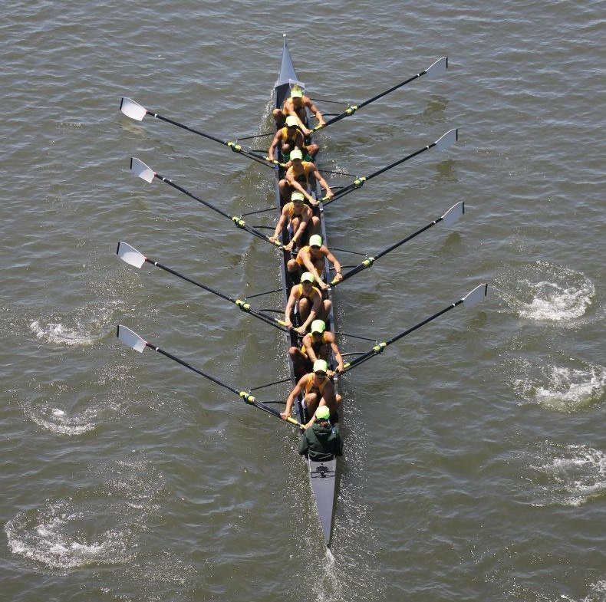
Questions?

